Slide 1
IF-5100
Programming for Data Analytics
Dataset 2: The Phishing
Kelompok 15:
23522003 - Moh. Laksamana Adhitama
23523003 - Richard Reinhart
23523007 - Istifa Shania Putri
November 2023

Slide 2
Outline
Introduction
Methodology
Result

Slide 3

Introduction
Phishing is the act of impersonating an official website to deceive users and steal personal data, often occurring in the online payments sector.
Objective in the form of building a classification model using machine learning to detect phishing websites.
https://medium.com/@ighadeer93_58983/phishing-websites-eda-exploratory-data-analysis-df80c9182d56
M. H. Alkawaz, S. J. Steven and A. I. Hajamydeen, "Detecting Phishing Website Using Machine Learning," 2020 16th IEEE International Colloquium on Signal Processing & Its Applications (CSPA)

Slide 4
System Framework
Input
EDA
Data Cleaning
Data pre-processing
XGBoost Classifier
Evaluation
Handling null value
Feature selection
Handling inconsistency value
Scaling
Convert dtype

Slide 5
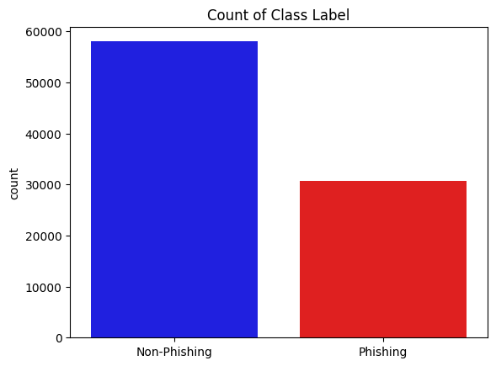
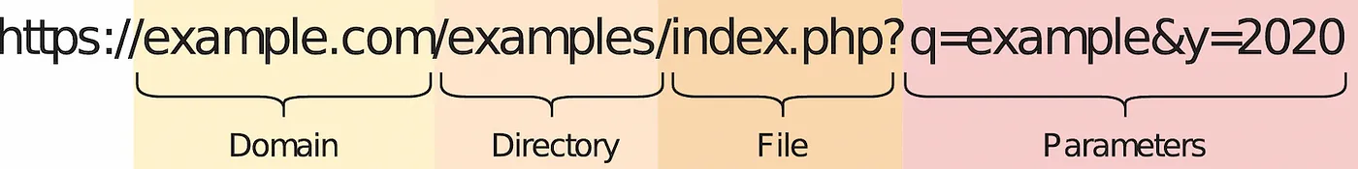
Data Understanding & EDA
Labeled, structured data ( 88647 x 112), Datatype: int, string
Mostly attribute in qty: url, domain, dir, file , params based (Fig 1.)
Imbalanced label ( Fig 2.)
Fig 1. Separation of the whole URL string into sub-strings
Vrbančič, G., Fister, I. and Podgorelec, V. (2020) ‘Datasets for phishing websites detection’,
Fig 2. Count of class label

Slide 6
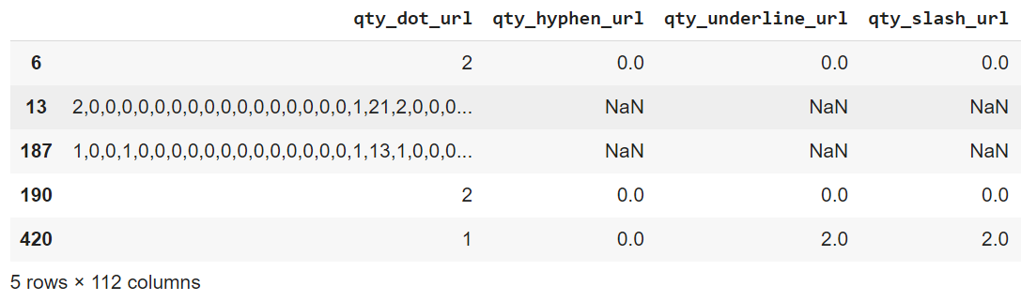
Data Understanding & EDA
Null values and inconsistency value
2,0,0,0,0,0,0,0,0,0,0,0,0,0,0,0,0,1,21,2,0,0,0,0,0,0,0,0,0,0,"",0,0,0,0,0,5,21,0,0,-1,-1,-1,-1,-1,-1,-1,-1,-1,-1,-1,-1,-1,-1,-1,-1,-1,-1,-1,-1,-1,-1,-1,-1,-1,-1,-1,-1,-1,-1,-1,-1,-1,-1,-1,-1,-1,-1,-1,-1,-1,-1,-1,-1,-1,-1,-1,-1,-1,-1,-1,-1,-1,-1,-1,-1,0,0.127553,-1,12488,7348,320,1,2,1,14396,1,0,0,0,0,0
1,0,0,1,0,0,0,0,0,0,0,0,0,0,0,0,0,1,13,1,0,0,0,0,0,0,0,0,0,0,0,0,0,"no",0,0,4,12,0,0,0,0,0,1,0,0,0,0,0,0,0,0,0,0,0,0,0,1,0,0,0,0,0,0,0,0,0,0,0,0,0,0,0,0,0,0,-1,-1,-1,-1,-1,-1,-1,-1,-1,-1,-1,-1,-1,-1,-1,-1,-1,-1,-1,-1,0,0.201418,-1,29182,2773,148,1,2,1,17141,1,0,0,0,0,0

Slide 7
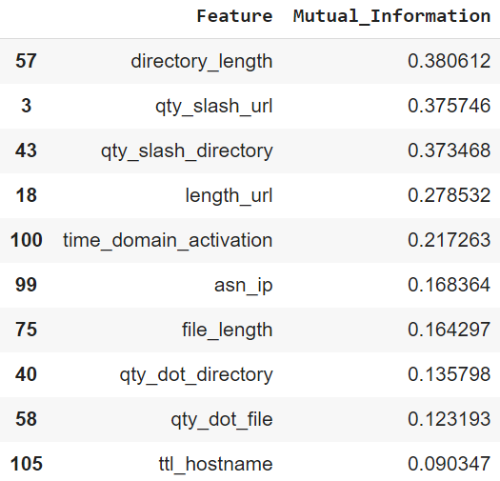
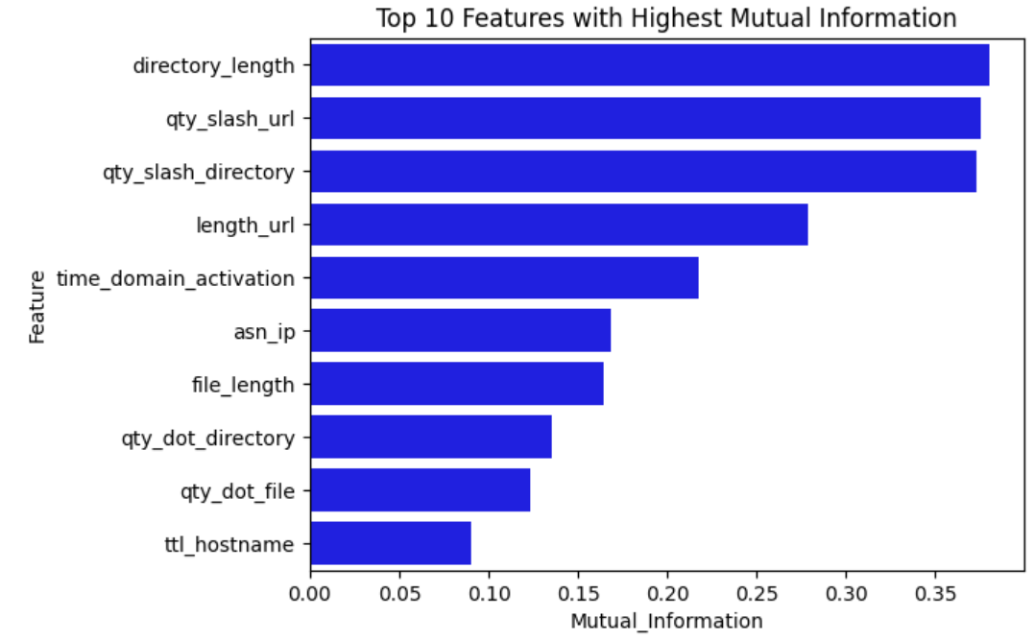
Data Understanding & EDA
Mutual information between feature and label column “Phishing”
“Higher Mutual Information, higher dependency between target and features.”
Guhanesvar (2021) Feature selection based on mutual information gain for classification and regression, Medium. Available at: https://guhanesvar.medium.com/feature-selection-based-on-mutual-information-gain-for-classification-and-regression-d0f86ea5262a (Accessed: 19 November 2023).

Slide 8
Data Cleaning
Separate value from first column at index 13 & 187, then distribute to rest of column
Replace strange string “” → mean of col, and “no” → 0
Replace -1 value into 0 for likelihood qty feature
Replace NaN into 0
Convert dtype into float

Slide 9
Data Pre-processing
Select features that have Mutual Information greater than 0.1 as data input into classifier
['directory_length', 'qty_slash_url', 'qty_slash_directory',
'length_url', 'time_domain_activation', 'asn_ip', 'file_length',
'qty_dot_directory', 'qty_dot_file']
Scaling using MinMaxScaler
Split dataset into train and test set (80:20)

Slide 10
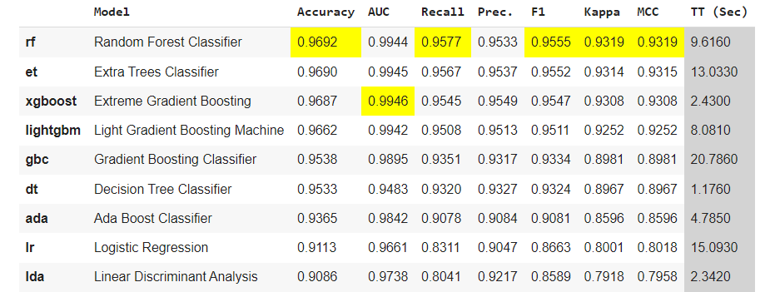
Modeling using Pycaret
Pycaret is a library that could generate some machine learning algorithms and sort based on the model performance.
XGBoost produce good performance with minimum training time than the other algorithms.

Slide 11
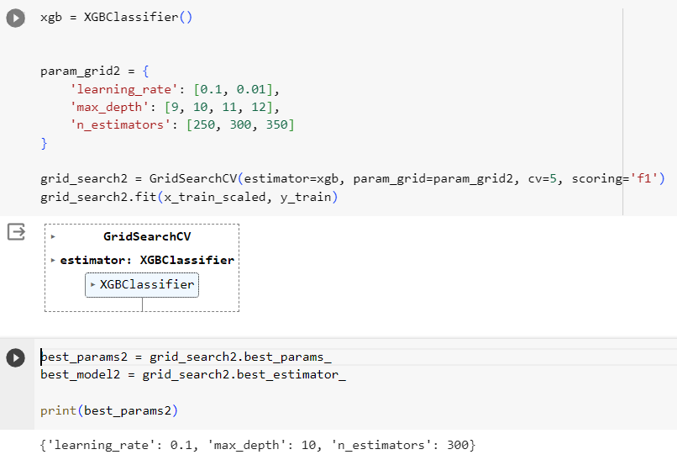
Modeling using XGBoost
XGBoost Classifier

Slide 12
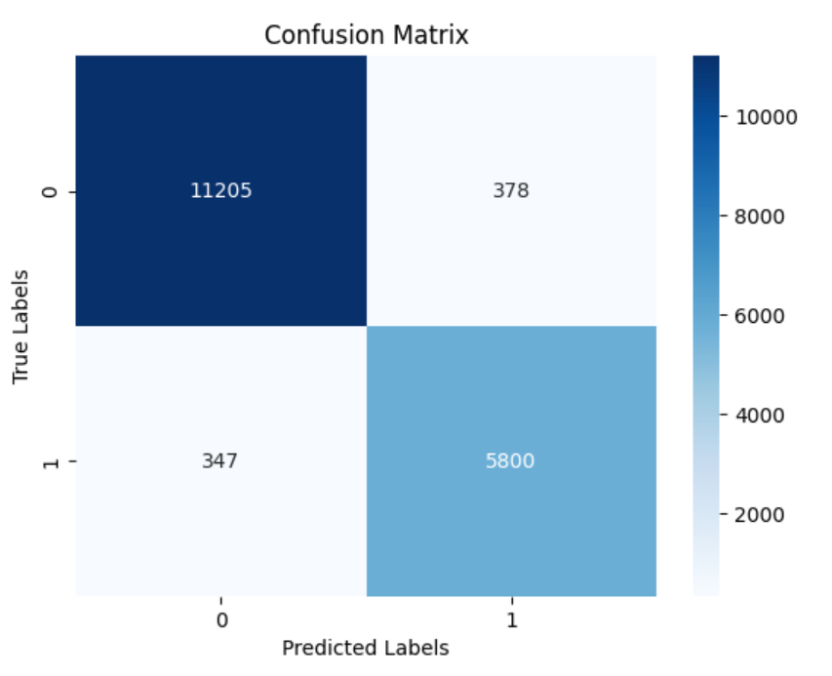
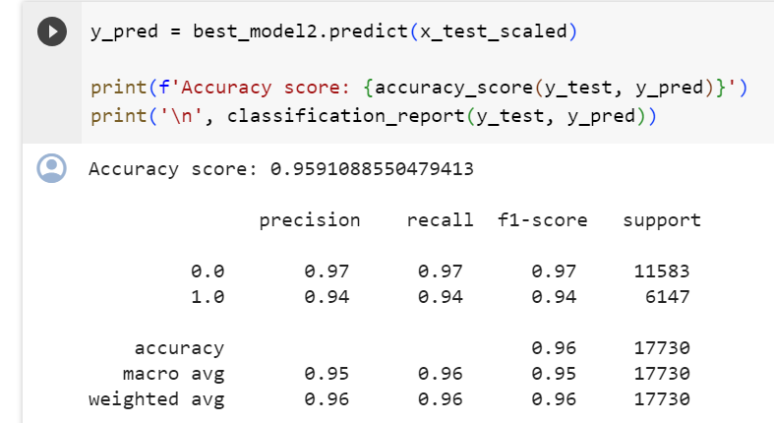
Evaluation
Metrics performance based on accuracy

Slide 13
Conclusion
Data understanding and EDA is important to know deeper about the data and can make strategy to clean the data
Data preprocessing is also important to produce a good performance machine learning model
Determined the best algorithm for build the machine learning model with good performance and minimum training time

Slide 14
Thank you.

